Slide 1
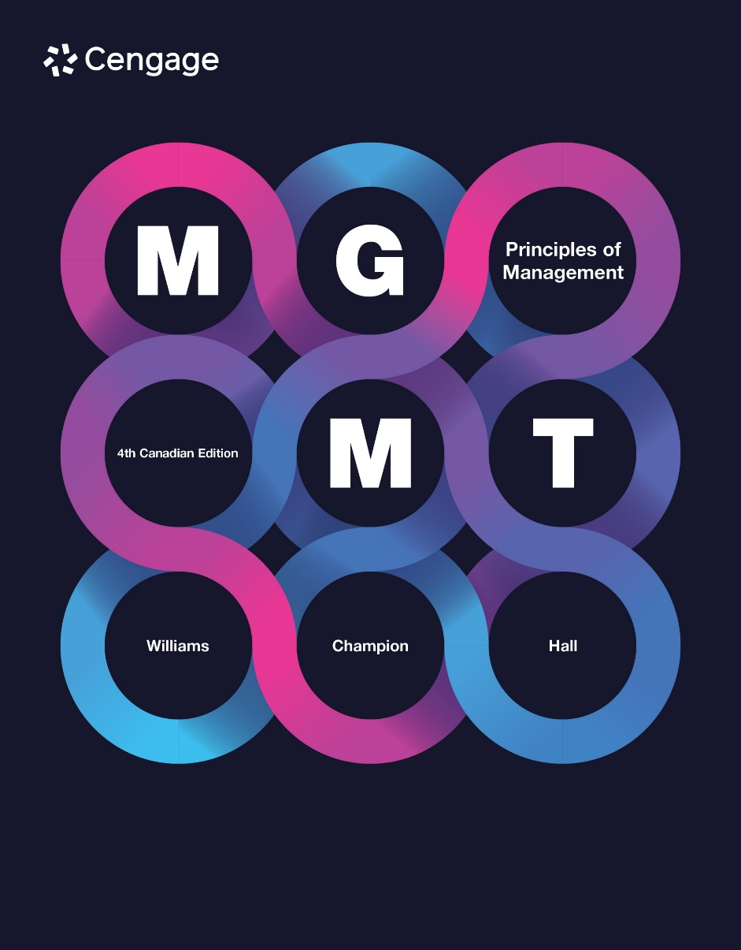

Slide 2
Chapter 16
Managing Information in a Global World
Dr Ike
16 Oct 2025

Slide 3
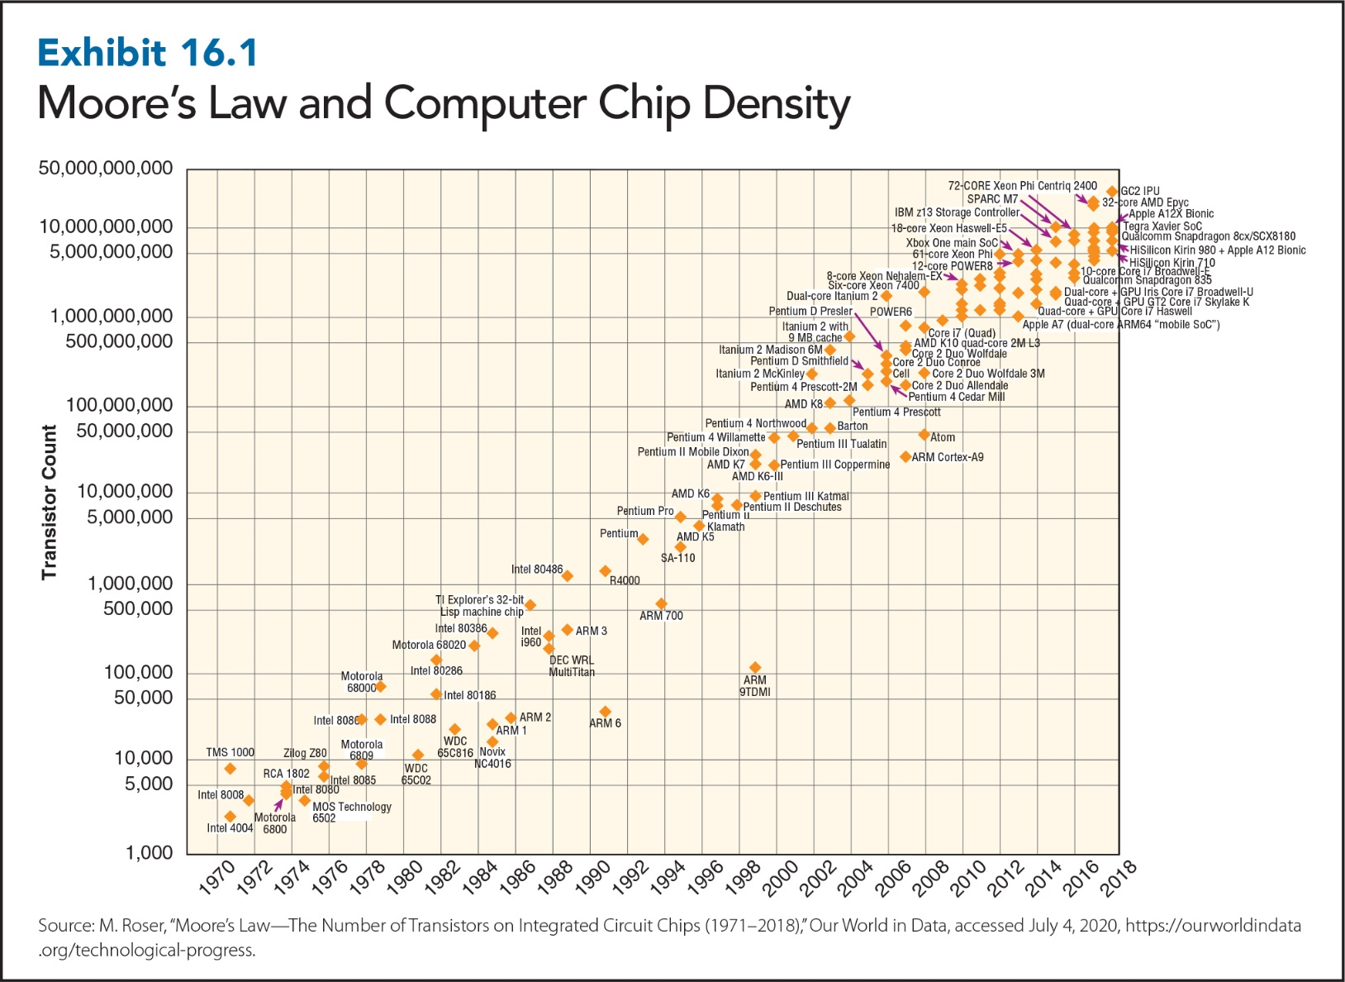
16-3
Notes:
Moore’s law: the prediction that the cost of computing will drop by 50 percent every 18 months as computer-processing power doubles. The exhibit shows that Gordon Moore, one of the founders of Intel Corporation, was right. In 1965, Moore predicted that computer-processing power would double and its cost would drop by 50 percent about every two years.
Computer power, as measured by the number of transistors per computer chip, has more than doubled every few years. Consequently, the device sitting on your lap or on your desk or in your pocket is not only smaller but also much cheaper and more powerful than the large mainframe computers used by Fortune 500 companies 40 years ago. For instance, your iPhone replaces 13 of the 15 items, such as a desktop computer, mobile phone, CD player, camcorder, etc., commonly sold by Radio Shack in 1991, items that would have cost you $3,071.21 then, or, after adjusting for inflation, over $5,000 today. So your $900 iPhone not only replaces a trunkful of 1991 electronics gear, it does so for a fraction of the cost.
Likewise, in 2001, the cost of sequencing one human genome was $100 million. Thanks to Moore’s law, that cost was only $1,000 in 2020.

Slide 4
Why Information Matters
Raw data: facts and figures
Information: useful data that can influence someone’s choices and behaviour
Information has context; data does not.
Notes:
Raw data: facts and figures
Information: useful data that can influence people’s choices and behaviour
In today’s hypercompetitive business environment, information is as important as capital (i.e., money) for business success, whether it relates to product delivery, product inventory, pricing, or costs. It takes money to get a business started, but a business can’t survive and grow without the right information.

Slide 5
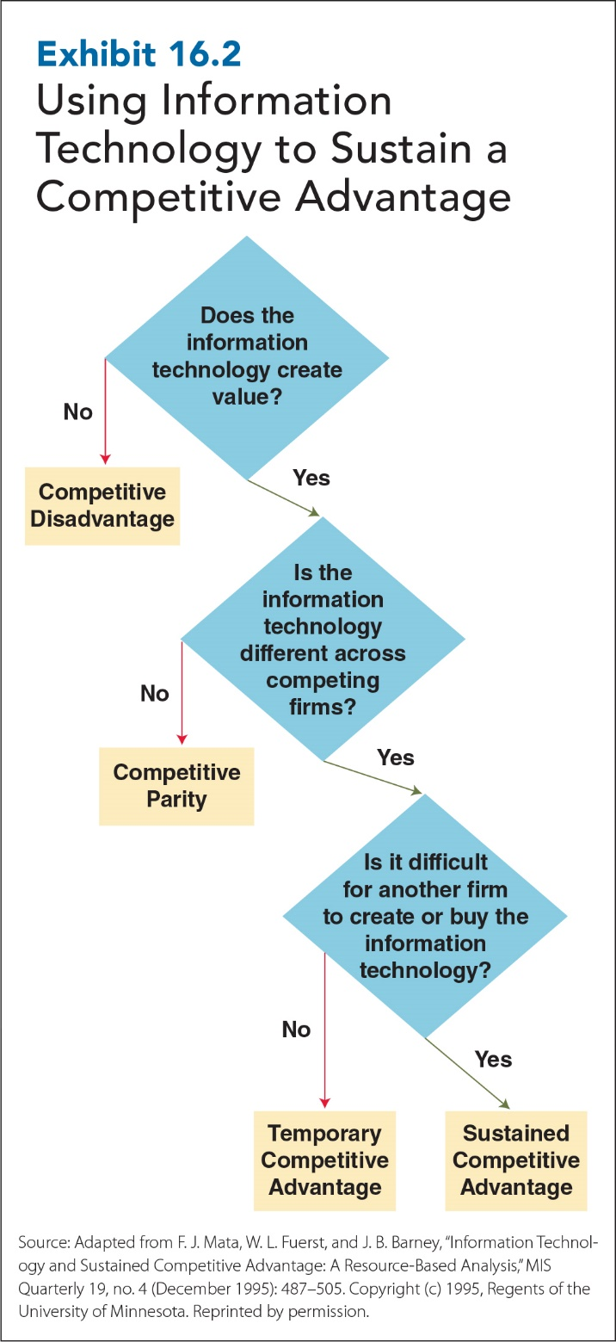
16-5
Notes:
According to the resource-based view of IT, companies need to address three critical questions in order to sustain a competitive advantage through IT:
First, does the IT create value for the firm by lowering costs or providing a better product or service? If the IT doesn’t add value, then investing in it will put the firm at a competitive disadvantage relative to companies that choose IT that does add value.
Second, is the IT the same or different across competing firms? If all firms have access to the same IT and use it in the same way, then no firm has an advantage over another (i.e., there is competitive parity).
Third, is it difficult for other companies to create or buy the IT they use? If it is, then the firm that has acquired the IT has established a sustainable competitive advantage over its competitors. If it is not, then the competitive advantage is only temporary, and competitors should eventually be able to duplicate the advantages that the leading firm has gained from IT.
The key to sustaining competitive advantage is using information technology to continuously improve and support the core functions of the business.
Savvy businesses use social media to improve customer service. The staff of leading hotels, for example, search for any mention of their hotel on Twitter, Facebook, Tumblr, and websites like tripadvisor.ca. When they find a complaint, they offer an immediate apology and, more often than not, perks like a room upgrade or a free meal as compensation.

Slide 6
Characteristics of Useful Information
Useful Information
Accurate
Complete
Relevant
Timely
16-6
Notes:
Information is useful when it is accurate. Before relying on information to make decisions, you must know that the information is correct.
Information is useful when it is complete. Incomplete or missing information makes it difficult to recognize problems and identify potential solutions.
You can have complete, accurate information, but it’s not very useful if it isn’t relevant; i.e., if it doesn’t pertain to the problems you’re facing.
Information is useful when it is timely. The information must be available when needed to define a problem or to begin to identify possible solutions.

Slide 7
Communication Costs Associated with Useful Information
Storage
Communication
Acquisition
Processing
Retrieval
16-7
Notes:
Acquisition cost: cost of obtaining data you don’t have
Processing cost: cost of turning raw data into usable information
- Data silo: isolated data set difficult to obtain, combine, or use with other company data
- Data variety: data formatted or structured in different ways
Storage cost: cost of physically or electronically archiving information for later use and retrieval
Retrieval cost: cost of accessing already-stored and processed information
Communication cost: cost of transmitting information from one place to another

Slide 8

Capturing Information: Electronic Era
Bar codes
QR codes
RFID tags
Sensors
Document scanners
Optical character recognition
16-8
Notes:
Bar code: a visual pattern that represents numerical data by varying the thickness and pattern of the vertical bars
QR (quick response) code: bar codes with black and white patterns scanned with your smartphone
Radio frequency identification (RFID) tags: tags containing minuscule microchips that transmit information via radio waves and can be used to track the number and the location of objects into which tags have been inserted
Sensors: Sensors detect an event or change and actively transmit that information to other electronic devices. An event, for example, could be someone entering or leaving a space, while a change could be temperature increasing or decreasing.
Document scanners: an electronic device that converts printed text and pictures into digital images
Optical character recognition: the ability of software to convert digitized documents into American Standard Code for Information Interchange (ASCII) text or PDF documents that can be searched, read, and edited by word processing and other kinds of software.
After data or documents have been entered, captured, or scanned with OCR, robotic data automation, also known as software bots, can be taught to recognize specific data patterns, such as dates, costs, and product numbers, in files, reports, or data silos. Once a pattern has been recognized, bots automatically scan, locate, and extract those data, compiling them into more useful forms and combinations.

Slide 9
Processing Information
Data Mining: Patterns and Relationships
Supervised
What if?
(Test)
Unsupervised
Why?
(Uncover)
16-9
Notes:
Processing information: transforming raw data into meaningful information
Data mining: the process of discovering patterns and relationships in large amounts of data. Data mining splits a data set in half, finds patterns in one half, and tests the validity of those patterns by trying to find them again in the second half of the data set. Data come from data warehouses. Data in data warehouses can be analyzed using two kinds of data mining: supervised and unsupervised.
Data warehouse: stores huge amounts of data that have been prepared for data mining analysis by being cleaned of errors and redundancy
Supervised data mining: the process in which a user tells data mining software to look and test for specific patterns and relationships in a data set. This is done through a series of “what if?” questions or statements.
Unsupervised data mining: the process in which a user simply tells the data mining software to uncover whatever patterns and relationships it can find in a data set. Unsupervised data mining is good at identifying association or affinity patterns, sequence patterns, and predictive patterns. It can also identify what data mining technicians call data clusters.
Association or affinity patterns: occur when two or more database elements tend to occur together in a significant way. One company found that beer and diapers tended to be bought together between 5 and 7 p.m. Question: Why? Answer: Parents, who were told by partners to buy diapers on the way home, also decided to pick up a six-pack.
Sequence patterns: when two or more database elements occur together in a significant pattern but one of the elements precedes the other
Predictive patterns: help identify database elements that differ
Data clusters: when three or more database elements occur together (i.e., cluster) in a significant way

Slide 10
Protecting Information
Authentication
Data
encryption
Authorization
SSL
Two-factor
authentication
VPN
Malware
EIS
Virus
Firewall
16-10
Notes:
Protecting information: the process of ensuring that data are reliably and consistently retrievable in a usable format for authorized users but no one else.
Authentication: making sure potential users are who they claim to be.
Authorization: granting authenticated users approved access to data, software, and systems.
Two-factor authentication: authentication based on what users know, such as a password, and what they have in their possession, such as a secure ID card or key.
Biometrics: identifying users by unique, measurable body features, such as fingerprint recognition or iris scanning.
Virus: a program or piece of code that, against your wishes, attaches itself to other programs on your computer and can trigger anything from a harmless flashing message to a reformatting of your hard drive to a system-wide network shutdown.
Data encryption: transformation of data into complex, scrambled codes that can be unencrypted only by authorized users who possess unique decryption keys.
Secure sockets layer (SSL): Internet browser–based encryption provides secure off-site web access to some data and programs.
Virtual private network (VPN): software that securely encrypts data sent by employees outside a company network, decrypts data when it arrives within a company computer network, and does the same when data is sent back to employees outside of the network.
Executive information system (EIS): data processing system that uses internal and external data sources to provide the information needed to monitor and analyze organizational performance.
Malware: Malware is a program or piece of code that, without your knowledge, attaches itself toother programs on your computer and can trigger anything from a harmless flashing message to the reformatting of your hard drive to a system-wide network shutdown.
Firewall: a protective hardware or software device that sits between computers in an internal organizational network and outside networks such as the Internet.

Slide 11
Accessing and Sharing Information and Knowledge
Internal
Executive information system (EIS)
Intranet
Corporate portal
External
EDI
Extranet
Knowledge
Decision support system (DSS)
Expert system
Artificial intelligence (AI)
16-11
Notes:
Internal
Executive information system (EIS): (a.k.a. “dashboard”) uses internal and external sources of data to provide managers and executives with the information they require to monitor and analyze organizational performance. The purpose of an EIS is to provide accurate, complete, relevant, and timely information to managers.
Intranet: private company networks that allow employees to access, share, and publish information using Internet software. Intranet websites are just like external websites, but the firewall separating the internal company network from the Internet permits only authorized internal access.
Corporate portal: a hybrid of EIS and intranets that allows managers and employees to access customized information and complete specialized transactions using a web browser. Hillman Group Canada sells the nuts, bolts, fasteners, keys, and key-cutting machines that you find in Home Depot, Lowes, Home Hardware, and nearly every other hardware store. Hillman’s 1,800 employees produce products for 25,000 customers worldwide. The company’s portal provides a real-time revenue report for every product it makes on a continuous basis, with updated production and sales numbers. This portal also offers 75 specialized reports, which are accessed by 800 managers and employees.
External
Electronic data interchange (EDI): allows two companies to convert purchase and ordering information to a standardized format to enable direct electronic transmission of that information from one company’s computer system to the other company’s
Extranets: networks that allow companies to exchange information and conduct transactions with outsiders by providing them direct, web-based access to authorized parts of a company’s intranet or information system
Knowledge
Decision support system (DSS): an information system that helps managers understand specific kinds of problems and potential solutions and analyze the impact of different decision options using “what if” scenarios
Expert system: an information system that contains the specialized knowledge and decision rules used by experts and experienced decision makers so that non-experts can draw on this knowledge base to make decisions
Artificial intelligence (AI): the capability of computerized systems to learn and adapt through experience

